Slide 1
ECEN 150 Circuit Analysis I
Current, Voltage, Power, Energy.

Slide 2
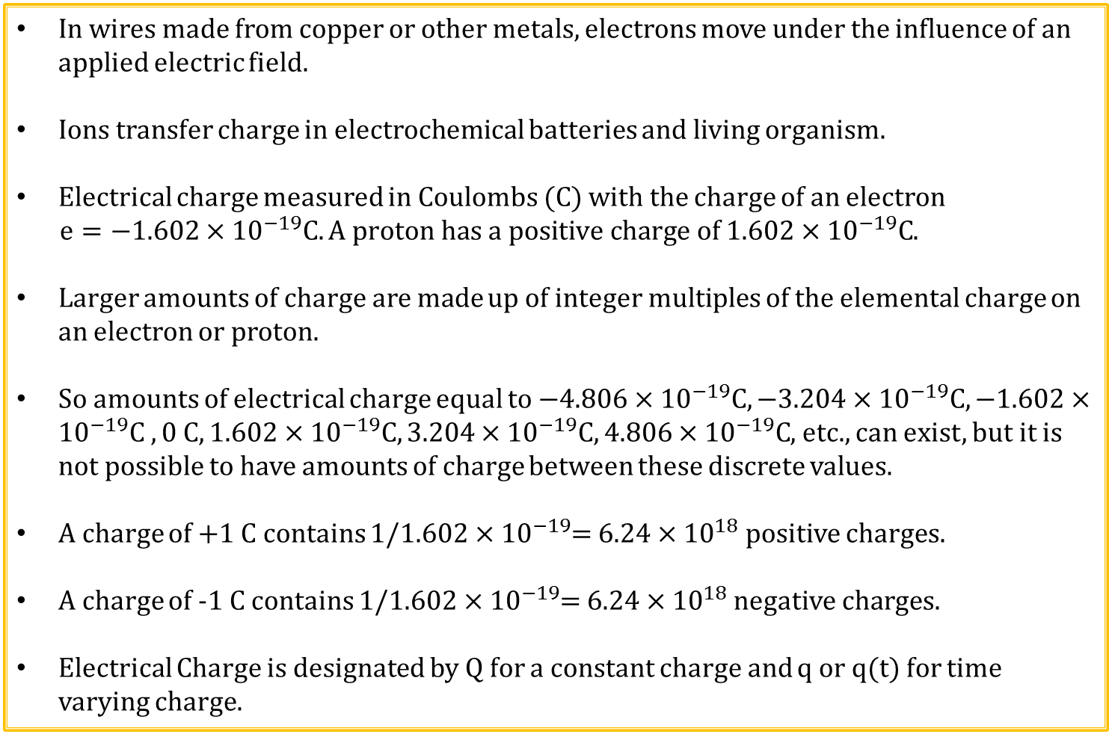
Electrical Charge
In wires made from copper or other metals, electrons move under the influence of an applied electric field.
Ions transfer charge in electrochemical batteries and living organism.
Electrical charge measured in Coulombs (C) with the charge of an electron
$e=−1.602×{10}^{−19}C. A proton has a positive charge of$ $1.602×{10}^{−19}C$.
Larger amounts of charge are made up of integer multiples of the elemental charge on an electron or proton.
So amounts of electrical charge equal to$−4.806×{10}^{−19}C,−3.204×{10}^{−19}C, −1.602×{10}^{−19}C , 0 C, 1.602×{10}^{−19}C, 3.204×{10}^{−19}C, 4.806×{10}^{−19}C$, etc., can exist, but it is not possible to have amounts of charge between these discrete values.
A charge of +1 C contains 1/$1.602×{10}^{−19}$= $6.24×{10}^{18}$ positive charges.
A charge of -1 C contains 1/$1.602×{10}^{−19}$= $6.24×{10}^{18}$ negative charges.
Electrical Charge is designated by Q for a constant charge and q or q(t) for time varying charge.
Notes:
Created graphic in illustrator

Slide 3
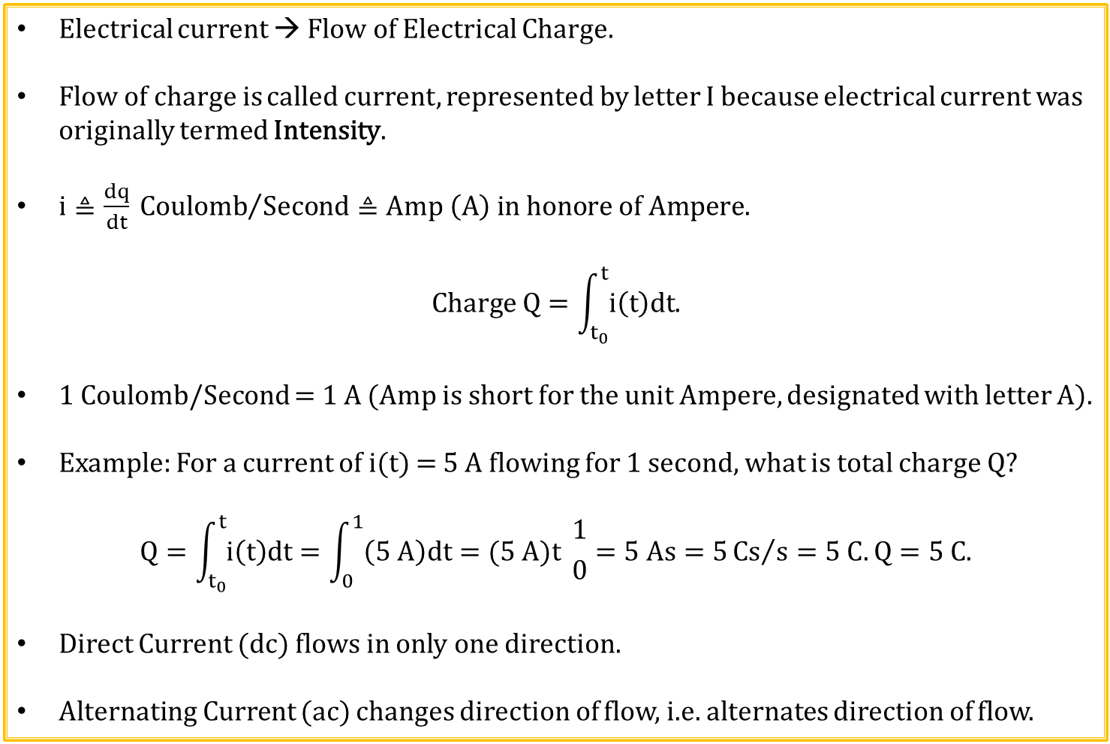
Electrical Current
Electrical current → Flow of Electrical Charge.
Flow of charge is called current, represented by letter I because electrical current was originally termed Intensity.
$i≜\frac{dq}{dt} {Coulomb}/{Second}≜Amp \left(A\right) in honore of Ampere.$
$$Charge Q=\int_{t_{0}}^{t}{i\left(t\right)dt.}$$
1 Coulomb/Second = 1 A (Amp is short for the unit Ampere, designated with letter A).
Example: For a current of i(t) = 5 A flowing for 1 second, what is total charge Q?
$$Q=\int_{t_{0}}^{t}{i\left(t\right)dt}=\int_{0}^{1}{\left(5 A\right)dt}=(5 A)t {1 \atop 0}=5 As=5{Cs}/s=5 C. Q=5 C.$$
Direct Current (dc) flows in only one direction.
Alternating Current (ac) changes direction of flow, i.e. alternates direction of flow.
Notes:
Created graphic in illustrator

Slide 4
Direct Current (dc)
Current
0 A
Time
Current
0 A
Time
Current changes values (ripples) in the above graph, but does not change direction, i.e. alternate polarity, so is not alternating current.

Slide 5
Direct and Alternating Current
Current
0 A
Time
Above current changes in amplitude, but not direction, i.e. current does not alternate polarity, so it is not alternating current.
Current
0 A
Time
Above current changes in amplitude and direction of flow, i.e. current alternates polarity, so it is alternating current (AC).

Slide 6
Conventional versus Electron Current Flow
In 1750 Benjamin Franklin’s came up with his Fluid Theory of electricity in which electrical current was assumed to be a charge transfer from positive (excess) to negative (deficit), resulting in an adopted convention of current flow from positive to negative, named conventional current flow. Conventional current flow correctly explains charge transfer associated with positive charges including protons (ionized hydrogen atoms) along with other positive ions in gasses and solutions.
However, current flow in a metal wire is due to electrons, which by definition have a negative charge. So when current flows in a metal wire, it is actually electrons moving from a negative to positive voltage, referred to as electron current flow, which correctly describes the charge transfer process in metals and electronic devices like resistors.
Today, conventional current flow (assumed positive charge transfer from + to -) is traditionally used when analyzing circuits, whereas electron current flow (electrons moving from – to +) is used when describing the actual charge transfer process inside many electrical components including wires and resistors. For circuit analysis, it actually doesn’t matter if charge transfer occurs by means of conventional current flow or electron current flow, the results are the same, so conventional current flow lives on and we in electronics learn to deal with it.

Slide 7
Conventional versus Electron Current Flow
Electric Field
Conventional Current Flow
+
+
+
+
+
+
+
+
+
+
+
+
+
Electric Field
Electron Current Flow
Voltage polarity is the same either way.

Slide 8
Conventional versus Electron Current Flow
Electric Field
+
+
+
+
+
+
+
Electric Field
+
+
+
+
+
+
+
Electric Field
+
+
+
+
+
+
+
In a copper wire, only electrons contribute to current flow, not fixed metal atoms held together by covalent bonds. Free outer electrons hop from atom to atom, resulting in location of ionized atoms appearing to move in the opposite direction. Yet only electrons move in the wire.
So electrons moving to the left has the same affect as if positive charge moved to the right, which somewhat justifies the continuing usage of conventional current flow.

Slide 9

Conventional versus Electron Current Flow
Electronic devices like diodes and transistors use schematic symbols that indicate conventional current flow direction. Consequently, conventional current flow is most commonly used in electronics.
Almost all circuit classes use conventional current flow, realizing that at the atomic level electrons actually move in the opposite direction in wires and electronic devices such as diodes and transistor.
Conventional versus Electron Current Flow can be initially confusing, but is something that Electrical Engineers have successfully dealt with for some time.
Conventional Current Flow
Conventional Current Flow

Slide 10
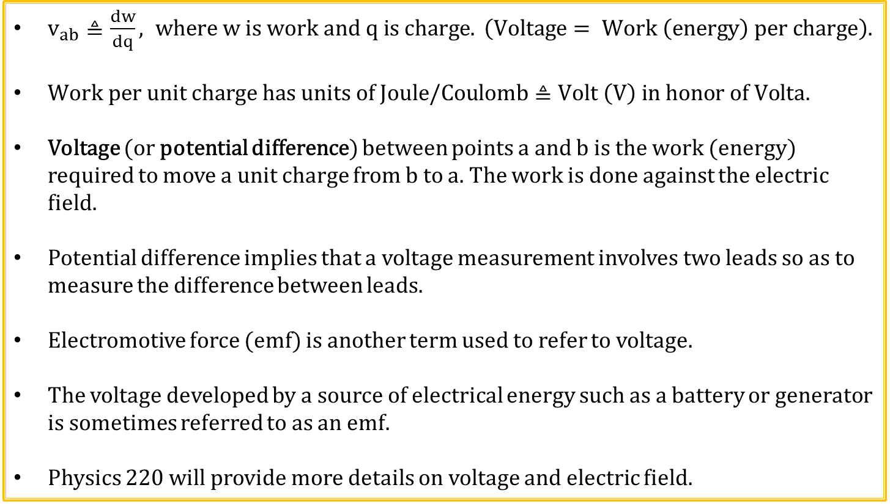
Voltage
$v_{ab}≜\frac{dw}{dq}, where w is work and q is charge. \left(Voltage= Work \left(energy\right) per charge\right).$
$Work per unit charge has units of Joule/Coulomb≜Volt \left(V\right) in honor of Volta.$
Voltage (or potential difference) between points a and b is the work (energy) required to move a unit charge from b to a. The work is done against the electric field.
Potential difference implies that a voltage measurement involves two leads so as to measure the difference between leads.
Electromotive force (emf) is another term used to refer to voltage.
The voltage developed by a source of electrical energy such as a battery or generator is sometimes referred to as an emf.
Physics 220 will provide more details on voltage and electric field.

Slide 11
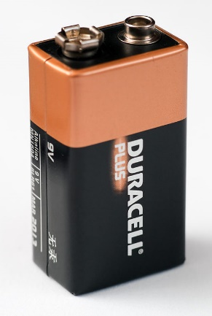
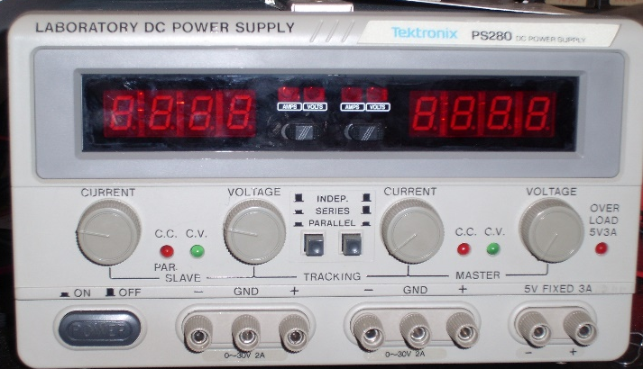
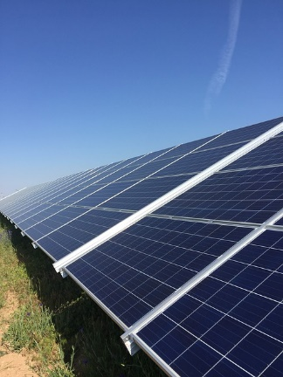


Common Sources of Voltage/EMF
A Battery
Adjustable Power Supply
Solar Panel
9 V
18 V output is common
Electric Power Plant
Nerve Cell
13,500 V
A few millivolts when activated by a synapse
Notes:
Battery: https://commons.wikimedia.org/wiki/File:Duracell_9_Volt_0849.jpg
Adjustable Power Supply: https://commons.wikimedia.org/wiki/File:Tektronix_PS280_DC_Power_Supply.jpg
Solar Panel: https://pixabay.com/en/solar-panel-solar-panels-renewable-1595566/
Power Plant: https://thumb7.shutterstock.com/display_pic_with_logo/3434117/559779094/stock-photo-turbine-generator-in-power-plant-with-blue-sky-559779094.jpg
Nerve Cell: https://thumb9.shutterstock.com/display_pic_with_logo/65904/128576345/stock-photo--d-rendered-illustration-nerve-cell-128576345.jpg

Slide 12
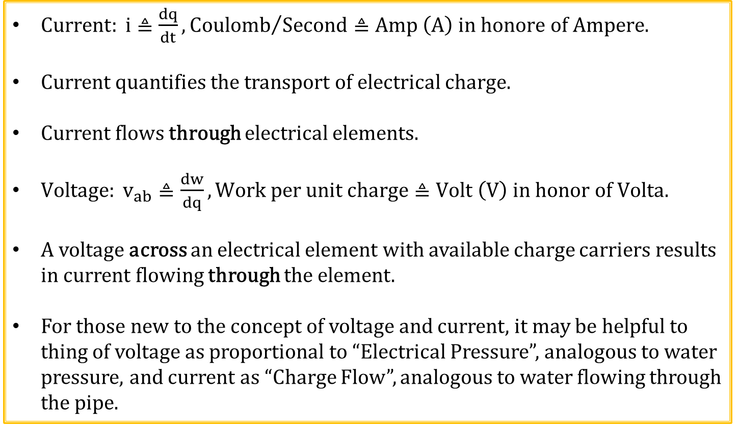
Current and Voltage
$Current: i≜\frac{dq}{dt},{Coulomb}/{Second}≜Amp \left(A\right) in honore of Ampere.$
Current quantifies the transport of electrical charge.
Current flows through electrical elements.
${Voltage: v}_{ab}≜\frac{dw}{dq},Work per unit charge≜Volt \left(V\right) in honor of Volta.$
A voltage across an electrical element with available charge carriers results in current flowing through the element.
For those new to the concept of voltage and current, it may be helpful to thing of voltage as proportional to “Electrical Pressure”, analogous to water pressure, and current as “Charge Flow”, analogous to water flowing through the pipe.

Slide 13
Voltage and Current Sources
An ideal voltage or current source provides the defined output voltage or current independent of other circuit elements.
Hence, the theoretical ideal voltage or current source can supply an infinite amount of energy.
A voltage or current source is independent if the ideal output voltage or current is not dependent upon other circuit elements or values.
A voltage or current source is dependent if the ideal output voltage or current is dependent upon other circuit elements or values.
An example of a dependent voltage source is the output voltage of amplifier that is dependent upon the input voltage, such as an audio gain amplifier.
An example of a dependent current source is the output current of transistor that is dependent upon the input voltage applied to the transistor.

Slide 14
Independent dc Voltage and Current Sources
Battery which is
A special case of an independent DC Voltage Source.
Independent
Voltage Source
+
v_{out}
+
+
v_{oc}
v_{oc}
_
V_{oc}
-
-
0
∞
i_{out}
Independent
Current Source
i_{out}
+
i_{sc}
i_{sc}
-
0
∞
v_{out}
The theoretical ideal independent voltage or current sources can supply an infinite amount of energy.

Slide 15
Dependent Voltage and Current Sources
Dependent
Voltage Source
+
v_{out}
+
v_{oc}
v_{oc}
_
-
0
∞
i_{out}
Dependent
Current Source
+
i_{out}
i_{sc}
i_{sc}
-
0
∞
v_{out}
The theoretical ideal dependent voltage or current source can supply an infinite amount of energy.

Slide 16
Dependent Voltage Sources
Voltage-Controlled Voltage Source (VCVS)
+
Av_{in}
+
+
v_{out}= Av_{in}
_
v_{in}
Circuit
Element
-
-
Current-Controlled Voltage Source (CCVS)
i_{in}
+
ki_{in}
+
+
v_{out}= ki_{in}
_
v_{in}
Circuit
Element
-
-

Slide 17
Dependent Current Sources
Current-Controlled Current Source (CCCS)
+
i_{b}
βi_{b}
+
i_{out}= βi_{b}
v_{in}
Circuit
Element
-
-
Voltage-Controlled Current Source (VCCS)
+
g_{m}v_{in}
+
i_{out}= g_{m} v_{in}
v_{in}
Circuit
Element
-
-

Slide 18
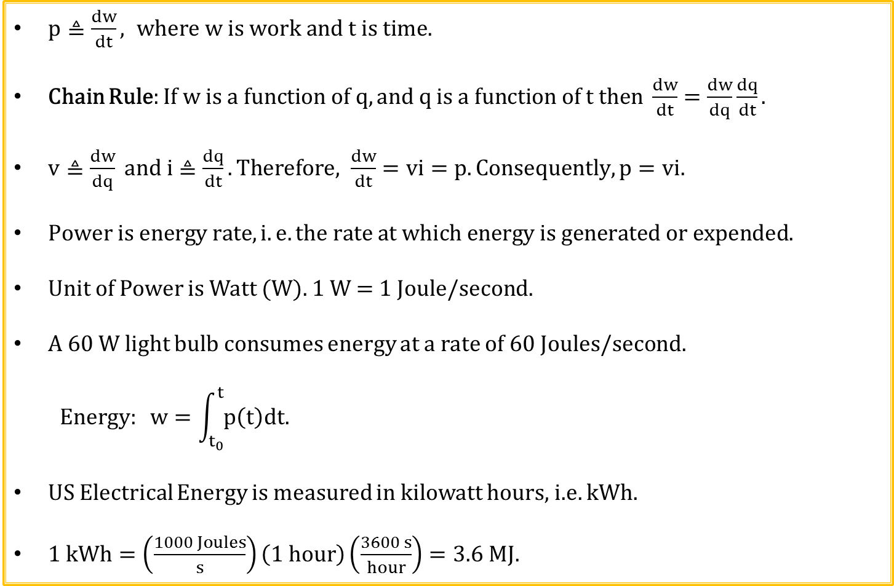
Electrical Power and Energy
$p≜\frac{dw}{dt}, where w is work and t is time.$
Chain Rule: $If w is a function of q, and q is a function of t then \frac{dw}{dt}=\frac{dw}{dq}\frac{dq}{dt}.$
$v≜\frac{dw}{dq} and i≜\frac{dq}{dt}. Therefore, \frac{dw}{dt}=vi=p. Consequently, p=vi.$
$Power is energy rate, i.e. the rate at which energy is generated or expended.$
Unit of Power is Watt (W). 1 W = 1 Joule/second.
A 60 W light bulb consumes energy at a rate of 60 Joules/second.
$$Energy: w=\int_{t_{0}}^{t}{p\left(t\right)dt.}$$
US Electrical Energy is measured in kilowatt hours, i.e. kWh.
$1 kWh=\left(\frac{1000 Joules}{s}\right)\left(1 hour\right)\left(\frac{3600 s}{hour}\right)=3.6 MJ.$

Slide 19
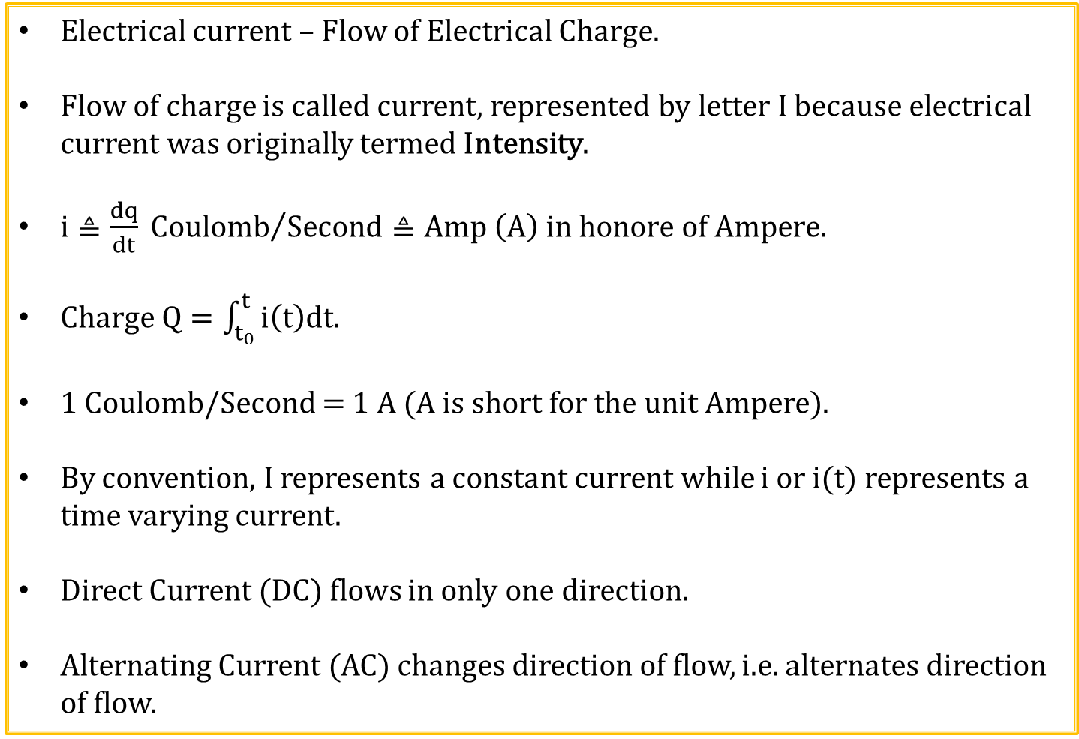
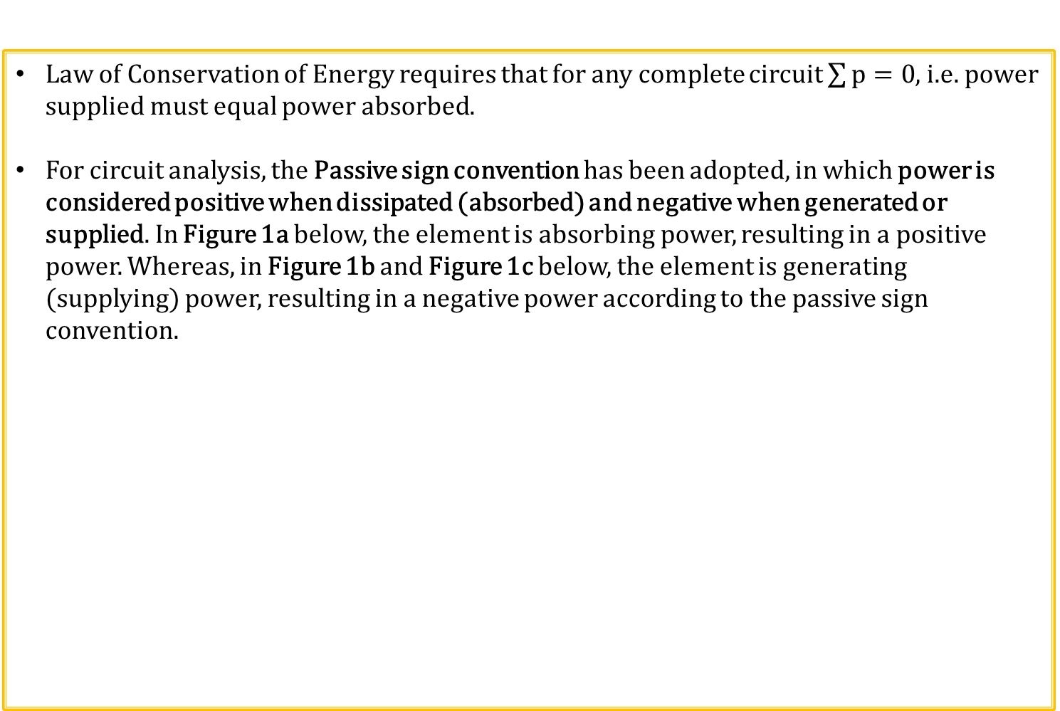
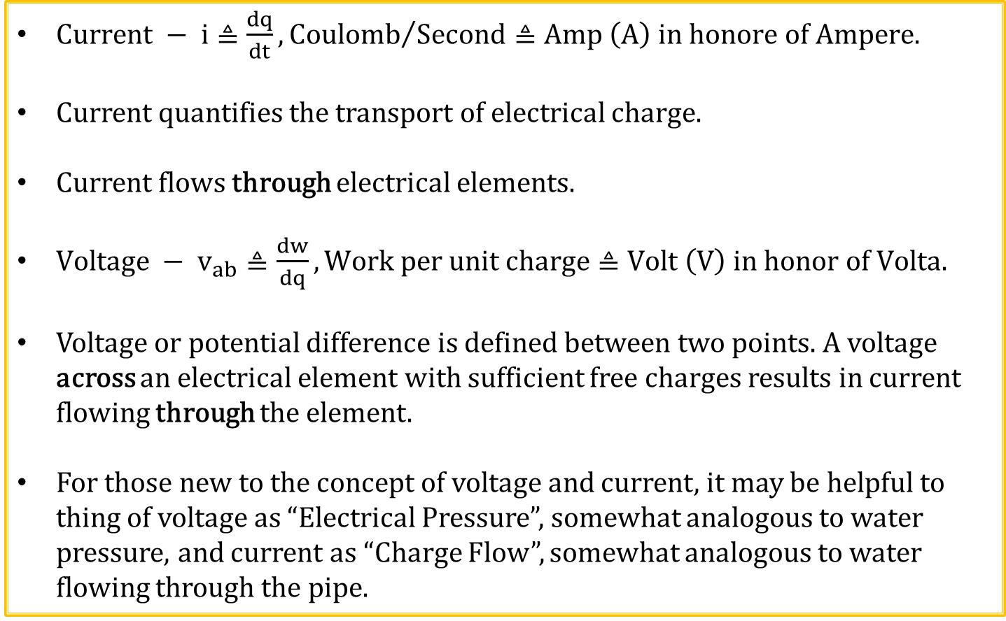

Passive Sign Convention
Law of Conservation of Energy requires that for any complete circuit $\sum{p=0}$, i.e. power supplied must equal power absorbed.
For circuit analysis, the Passive sign convention has been adopted, in which power is considered positive when dissipated (absorbed) and negative when generated or supplied. In Figure 1a below, the element is absorbing power, resulting in a positive power. Whereas, in Figure 1b and Figure 1c below, the element is generating (supplying) power, resulting in a negative power according to the passive sign convention.
$p=\left(5 V\right)\left(1 A\right)=$ 5 W.
$p=\left(5 V\right)\left(−1 A\right)=$ -5 W.
$p=\left(5 V\right)\left(−1 A\right)=$ -5 W.
1 A
1 A
1 A
+
+
+
Element
Absorbing
Power
Element
Supplying
Power
+
Figure 1a.
5 V
Figure 1b.
5 V
Figure 1c.
5 V
_
-
-
-

Slide 20
Passive Sign Convention (Continued)
The Passive sign convention implies that positive conventional current flows from the higher to lower voltage in a passive device, such as a resistor so as to have the positive power dissipated in the passive device, i.e. the vi product ≥ 0.
Positive conventional current flows through a passive device from the higher to lower voltage, due to the passive sign convention.
5V
Element
Absorbing
Power
i_{R1}

Slide 21
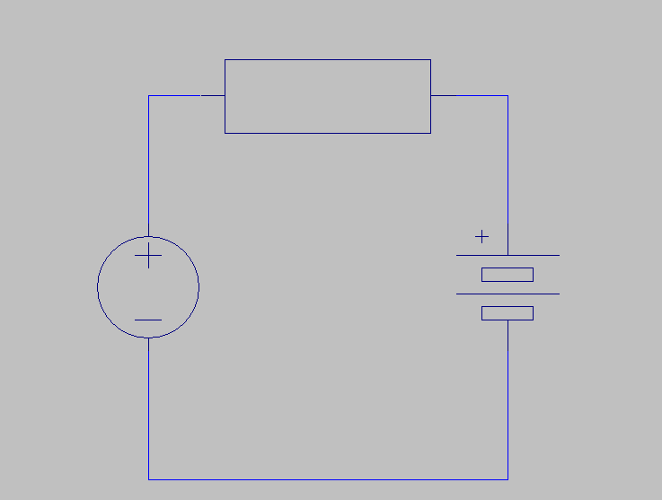
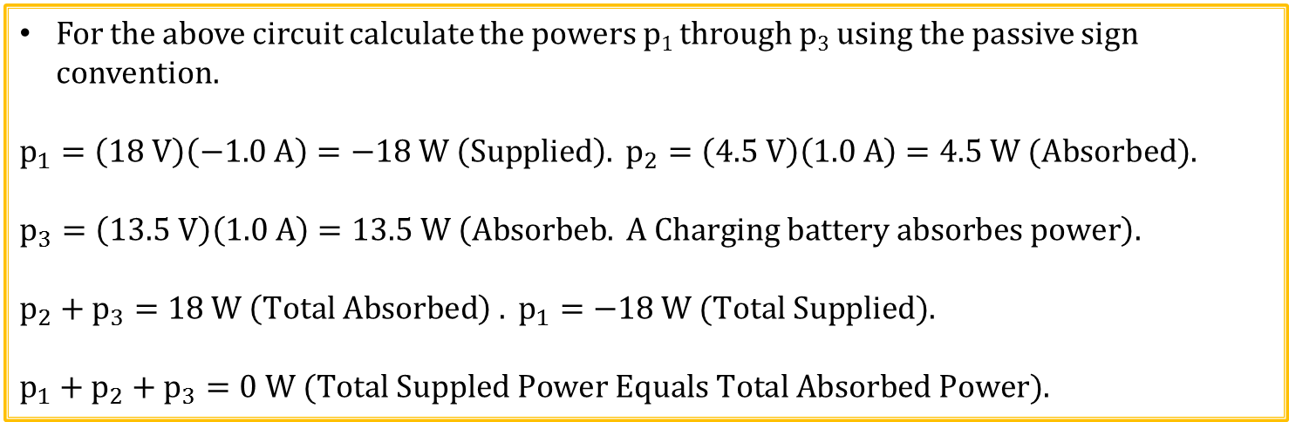
Circuit Element Power Calculation Example 1
p₂
+ 4.5 V -
1.0 A
18 V
p₁
13.5 V
p₃
For the above circuit calculate the powers p₁ through p₃ using the passive sign convention.
$$p_{1}=\left(18 V\right)\left(−1.0 A\right)=−18 W \left(Supplied\right). p_{2}=\left(4.5 V\right)\left(1.0 A\right)=4.5 W (Absorbed).$$
$$p_{3}=\left(13.5 V\right)\left(1.0 A\right)=13.5 W \left(Absorbeb. A Charging battery absorbes power\right).$$
$$p_{2}+p_{3}=18 W \left(Total Absorbed\right) . p_{1}=−18 W (Total Supplied).$$
$$p_{1}+p_{2}+p_{3}=0 W (Total Suppled Power Equals Total Absorbed Power).$$

Slide 22
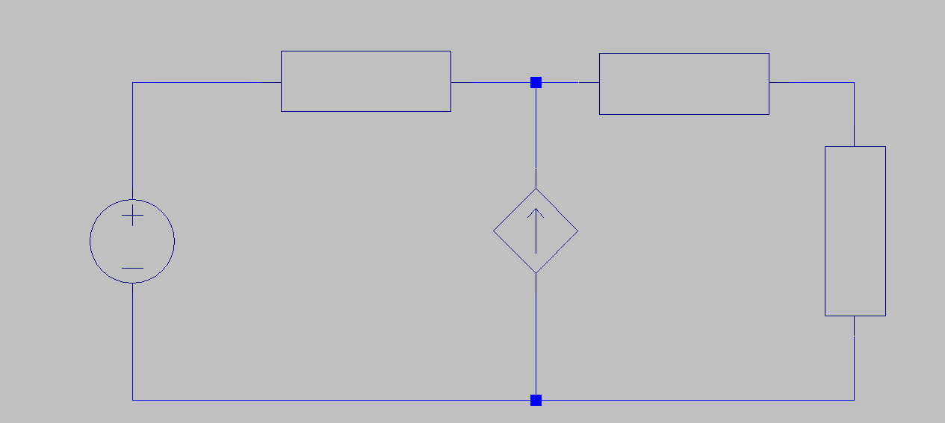
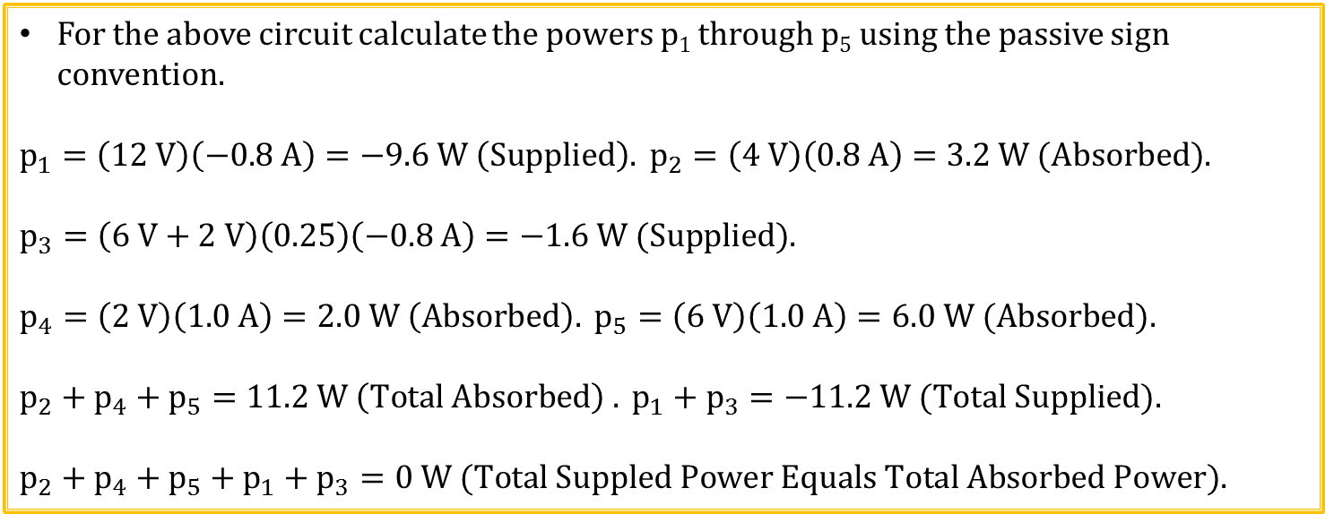
Circuit Element Power Calculation Example 2
I = 0.8 A
p₂
p₄
1.0 A
+ 4 V -
+ 2 V -
+
6 V
-
p₅
12 V
p₁
(0.25)I A
p₃
For the above circuit calculate the powers p₁ through p₅ using the passive sign convention.
$$p_{1}=\left(12 V\right)\left(−0.8 A\right)=−9.6 W \left(Supplied\right). p_{2}=\left(4 V\right)\left(0.8 A\right)=3.2 W (Absorbed).$$
$$p_{3}=\left(6 V+2 V\right)\left(0.25\right)\left(−0.8 A\right)=−1.6 W (Supplied).$$
$$p_{4}=\left(2 V\right)\left(1.0 A\right)=2.0 W \left(Absorbed\right). p_{5}=\left(6 V\right)\left(1.0 A\right)=6.0 W (Absorbed).$$
$$p_{2}+p_{4}+p_{5}=11.2 W \left(Total Absorbed\right) . p_{1}+p_{3}=−11.2 W (Total Supplied).$$
$$p_{2}+p_{4}+p_{5}+p_{1}+p_{3}=0 W (Total Suppled Power Equals Total Absorbed Power).$$

Slide 23
What are Employers Looking For?
Good problem solving methodology. Take stock of what you do know.
Problems to be solved are opportunities for engineers.
This is why most engineering classes typically provide ample problem solving opportunities.

Slide 24
When you come across a problem that you don’t understand, what should you do?
a. Look for a similar example in the text.
b. Search the internet for similar example. (Be careful on this one).
c. Find and watch an instructional YouTube video.
d. Contact a classmate for help.
e. Visit the instructor during office hours.
f. Make an appointment with a tutor.
g. Attend an open tutoring session.
h. Re-read the question searching for further understanding.
i. Take a break, hope for an aha moment, while doing something else.
j. Pray for guidance.
All of these suggestions are valid, depending upon the circumstances.
The point is that there is much that can be done on your part when confronted with this situation, which will likely happen over and over during your life.

Slide 25
Author’s Problem Solving Process
Carefully define the problem.
Present everything you know about the problem.
Establish a set of alternative solutions and determine the one that promises the greatest likelihood of success. (While this is often good practice in industry, it often isn’t done in courses where specific topics are being studied)
Attempt a problem solution.
Evaluate the solution and check for accuracy.
Has the problem been solved satisfactorily? If so, present the solution; if not, then return to step 3 and continue through the process again.

Slide 26
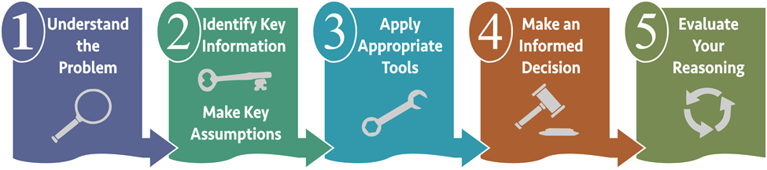
FDMAT108 Problem Solving Process
1. Understand the Problem.
The better you understand the problem, the more likely you are to solve it correctly.
2. Identify Key Information and Make Key Assumptions.
Assumptions often have to be made to real world problems in order to arrive at an actual solution.
3. Apply Appropriate Tools.
Tools include laws, principles and theorems along with software and hardware tools.
4. Make an Informed Decision.
Using results from steps 1 - 3, arrive at an answer or decision.
5. Evaluate Your Reasoning.
Is your approach defensible, and do your results seem reasonable. Often one can test or check a specific answer to verify that it conforms to fundamental laws, principles and theorems.

Slide 27
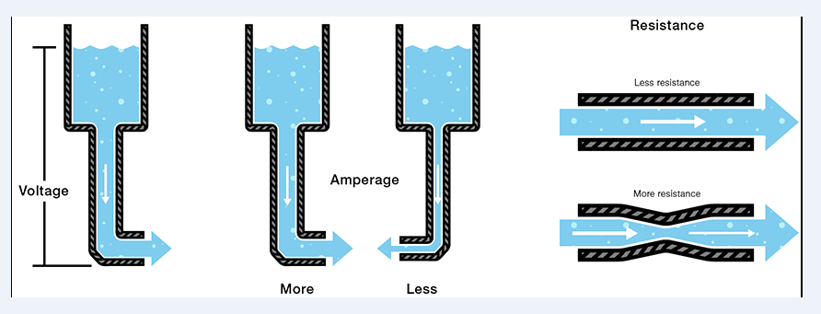
Water Analogy for Electricity
Voltage → Electrical pressure, (Volts - V). Analogous to water pressure.
Current → Flow of charge, (Amps - I). Analogous to water flow.
Resistance → Opposition to Current flow, (Ohms - Ω). Analogous to a constriction in a water pipe.
Notes:
https://learn.sparkfun.com/tutorials/transistors/extending-the-water-analogy

Slide 28
The End

Slide 29
Extra

Slide 30
ECEN 150 Course Topics
Basic Electrical Concepts: V, I, R, & P.
Analysis of DC Resistor (R) Circuits.
Operational Amplifiers (Op-Amps).
Capacitors (C) and Inductors (L).
Transient Analysis of RC and RL Circuits.
AC Sinusoids, Phasors and Impedance.
AC Power: Instantaneous, Average, and RMS.
Frequency Response and Filtering.

Slide 31
Practice Quiz Time
Which of the following result in a net positive charge?
1. Electrons.
2. Protons.
3. Atoms missing an electron.
4. Neutrons.
5. 2 and 3.
Answer: 5. Both 2 and 3 are correct.

Slide 32
Practice Quiz Time
Which of the following refers to the flow of electrical charge?
1. Voltage.
2. Current .
3. Resistance.
4. EMF.
5. All of the above.
Answer: 2. Current

Slide 33
Practice Quiz Time
Which of the following has units of volts?
1. Voltage.
2. Potential Difference.
3. EMF.
4. All of the above.
Answer: 4. All of the above.

Slide 34
Practice Quiz Time
Current is represented by which of the following symbols?
1. C.
2. V.
3. E.
4. I.
Answer: 4. I is the symbol for current.

Slide 35
Practice Quiz Time
Which of the following are true statements?
1. In conventional current flow charge flows from positive to negative.
2. Like charges repel.
3. In electron current flow, electrons flow from negative to positive.
4. Unlike charges attract.
5. All of the above.
Answer: 5. All of the above.

Slide 36
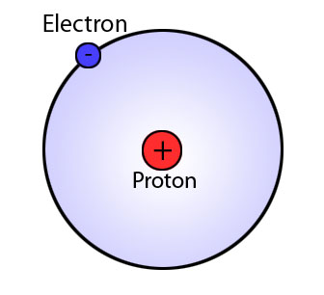
Basics of Electricity – Atomic Structure
Electron – Unit of negative charge.
Proton – Unit of positive charge.
Notes:
https://commons.wikimedia.org/wiki/File:Bohr_model.jpg

Slide 37
Conventional versus Electron Current Flow
In 1750 Benjamin Franklin’s came up with his Fluid Theory of electricity in which electrical current was assumed to be a charge transfer from positive (excess) to negative (deficit), resulting in an adopted convention of current flow from positive to negative, named conventional current flow. Conventional current flow correctly explains charge transfer associated with positive charges including protons (ionized hydrogen atoms) along with other positive ions in gasses and solutions.
However, current flow in a metal wire is due to electrons, which by definition have a negative charge. So when current flows in a metal wire, it is actually electrons moving from a negative to positive voltage, referred to as electron current flow, which correctly describes the charge transfer process in metals and electronic devices like resistors.
Today, conventional current flow (assumed positive charge transfer from + to -) is traditionally used when analyzing circuits, whereas electron current flow (electrons moving from – to +) is used when describing the actual charge transfer process inside many electrical components including wires and resistors. For circuit analysis, it actually doesn’t matter if charge transfer occurs by means of conventional current flow or electron current flow, the results are the same, so conventional current flow lives on and we in electronics learn to deal with it.

Slide 38
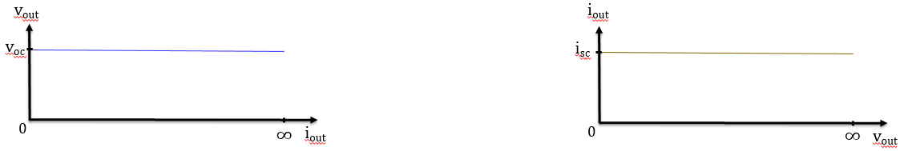
dc Voltage and Current Sources (Continued)
What happens if you short circuit the output of an ideal voltage source?
Infinite current flows, which is a problem. Shorting a real voltage source such as a 12 V lead-acid car battery results in very large (> 200 A) currents and is to be avoided.
What happens if you open circuit the output of an ideal voltage source?
No problems. No current flows and output simply equals the open circuit voltage.
What happens if you short circuit the output of an ideal current source?
No problems. Current i_{sc} simply flows in the short circuit.
What happens if you open circuit the output of an ideal current source.
Output voltage goes to infinity, resulting in arcing across the output terminals. While practical current sources can’t provide infinite output voltage, open-circuiting the output of a current source is to be avoided so as to prevent excessive output voltage.
Ideal Voltage Source
Ideal Current Source

